Slide 1
A LABS Technical Test
Name: Harsh Kumar
Email: harshkumar672001@gmail.com

Slide 2
Objective
The objective of this case study is to work e-commerce data sets and use data analysis tools such as Power BI, or other Business Intelligence (BI) tools to derive valuable insights And create informative dashboards.

Slide 3
Questions
1➔ What variables can be derived out of the data which can be helpful?
Here We derive variables such as average, median, mode, standard deviation, variance, correlation coefficient And more depending on data
2➔. Who can use this dashboard?
this Dashboard is used by team members or stakeholders who interested in the insights that i have derived from the data.
3➔ What value would be generated using this dashboard?
The value generated using this dashboard would depend on the insights from the data. It could be anything from identifying trends to making informed decisions.
4➔ What additional data can be helpful to add more insights & value to the team?
Additional data such as demographic data, geographic data, psychographic data` can be helpful in adding more insights and value to the team.

Slide 4
About Data
1. Sales_Data_Ecommerce : The entire customer behavior data
2. Promotion: This is promotion data set of special promotions for that day. One product will be promoted in first page of app/website. In addition to that there are many promotions running however the data is limited special promotion.

Slide 5
Business Questions:
1. How the price is varying by brand/category/time/channel?
2. Is traffic varied by day/time/channel?
3. Define & calculate high level metrics like (Revenue, potential revenue, products, categories etc.…) by month, time, state, channel etc…
4. What is Activity by Brand or category, brad preference, Brand activity by various parameters etc...?
5. How is the search behavior like Brand Search by Category/Category search by Brand?
6. What is effect of Special Promotions?
7. How Pricing fluctuations effecting sales?
8. What is price vary statewise?

Slide 6
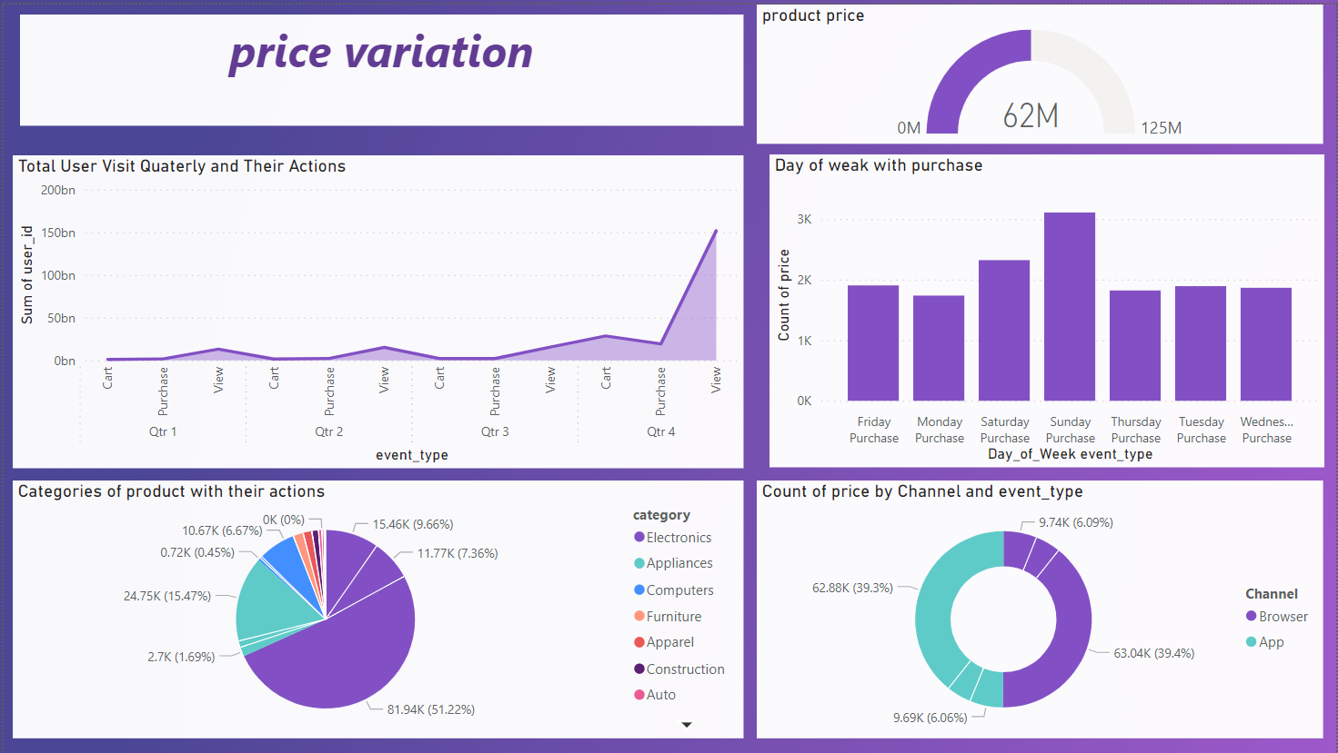

Slide 7
Yes Price variations over time brand category but not channel
1. Brand:
Different brands often have varying pricing strategies . Prices can vary widely between brands for similar products due to differences in quality, brand loyalty, and customer perception.
2. Category:
Prices can differ significantly across product categories due to factors such as production costs, supply and demand dynamics, and market competition. For example, electronic gadgets might have different price variations compared to groceries or fashion items.
3. Time:
Price variations over time can be influenced by factors. Prices might be higher during seasons or when a product is newly launched, and they may decrease as the product matures or during off-peak times.
4. Channel:
Price variations not over channel so it can not influenced by factors

Slide 8
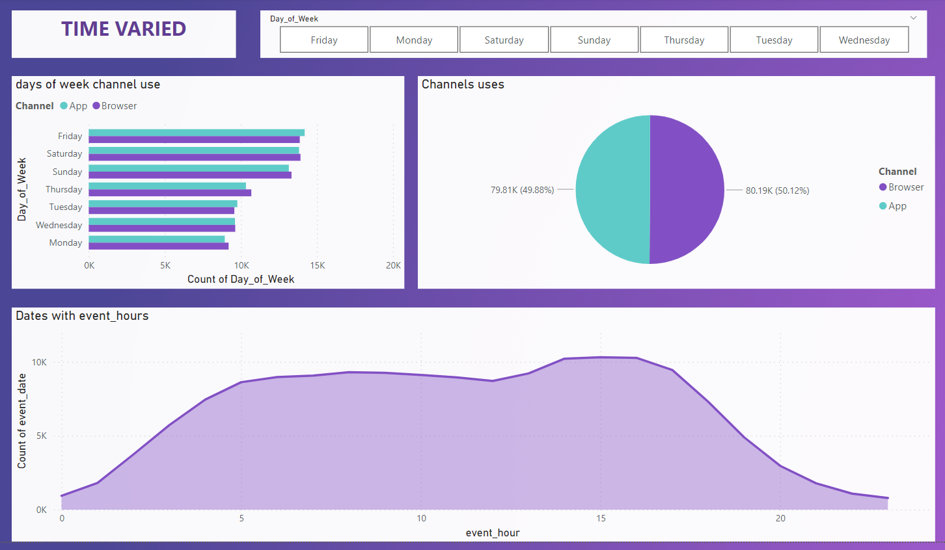

Slide 9
The variation in web traffic based on day, time, and channel
Traffic tends to be higher during weekdays (Monday to Friday) as people use the internet for work, education, and daily tasks. On weekends (Saturday and Sunday), traffic might decrease slightly as people engage in leisure activities.
Peak hours often coincide with regular daily routines, such as morning (8 AM to 10 AM) and late afternoon (2 PM to 4 PM) when people are more likely to be active online.
traffic might differ between browser and mobile devices. Mobile usage tends to peak during commuting hours and evenings, while browser usage might be higher during typical working hours.

Slide 10
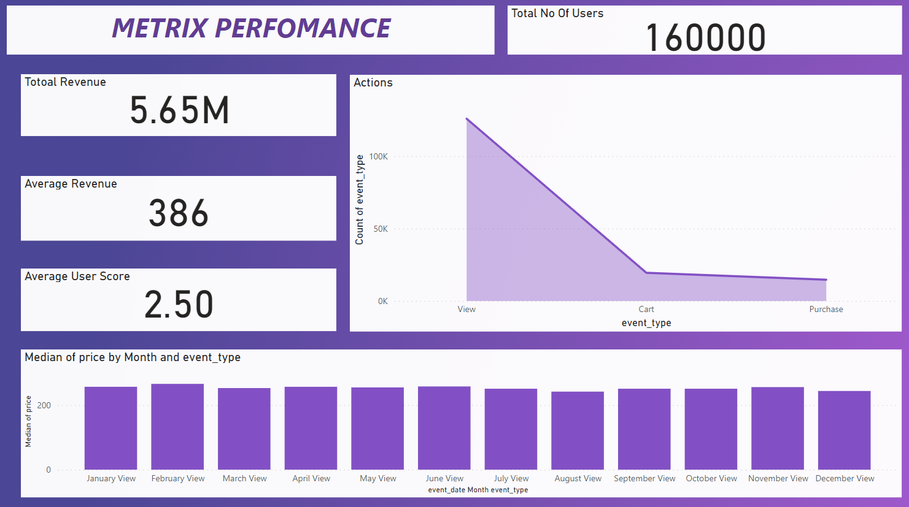

Slide 11
High-level metrics are key performance indicators (KPIs) that provide a broad overview of a business's performance and growth. These metrics help measure the success of various aspects of the business, such as revenue generation, product performance, and market reach.
Revenue
Definition: Total income generated from sales of products
Calculation: Sum of all sales transactions within a specific period (month, quarter, year).
Potential Revenue:
Definition: Estimated maximum achievable revenue based on market demand and ideal conversion rates.
Calculation: Potential Revenue = Total Addressable Market (TAM) * Conversion Rate.

Slide 12
Activity by brand or category is the level of engagement, interactions, or transactions related to specific brands or product categories within a given timeframe. It involves measuring and analyzing customer actions, such as purchases, clicks, likes, shares, and comments, to understand the popularity and performance of different brands or categories as mention in Dashboard

Slide 13
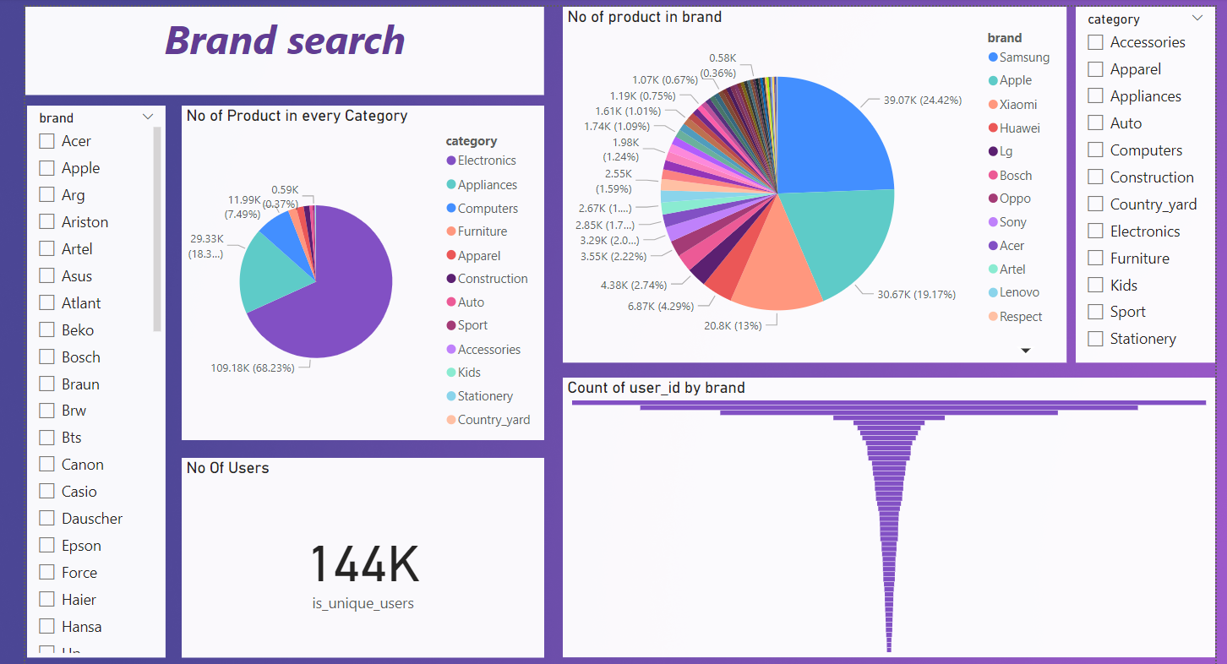

Slide 14
Search behavior refers to the way users search for information, products in our case two specific search behaviors stand out: brand search by category and category search by brand.
Brand Search by Category:
This search behavior occurs for products offered by a particular brand within a certain category like apple or Samsung
Category Search by Brand:
category search by brand happens with product category and want to explore different brands that offer products within that category. just like i our case many user want only smartphones they see all smartphones with differ brands

Slide 15
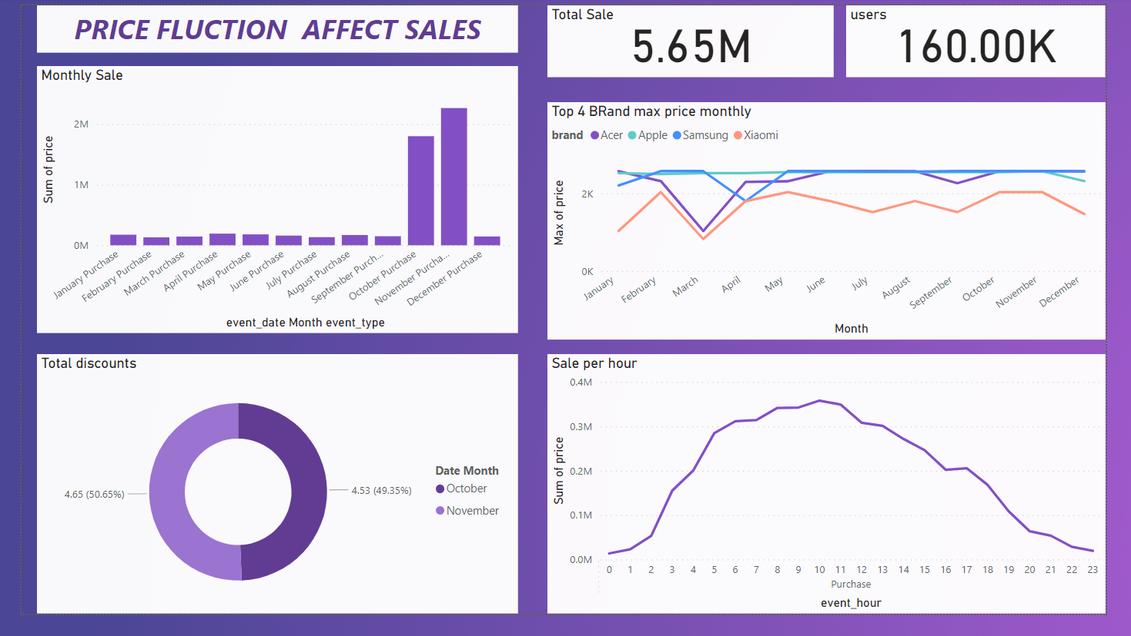

Slide 16
The effects of special promotions covers the positive and potential challenges associated with special promotions
as we seen in our data when we give discounts promotion so it effect the sale and increase the sale by good results
pricing fluctuations can impact customer acquisition and retention efforts as we see in our case
Lower prices might attract new customers, but if not managed well, these customers may leave once prices return to normal.
Fluctuating prices can lead to higher customer churn rates as customers seek out better deals.

Slide 17
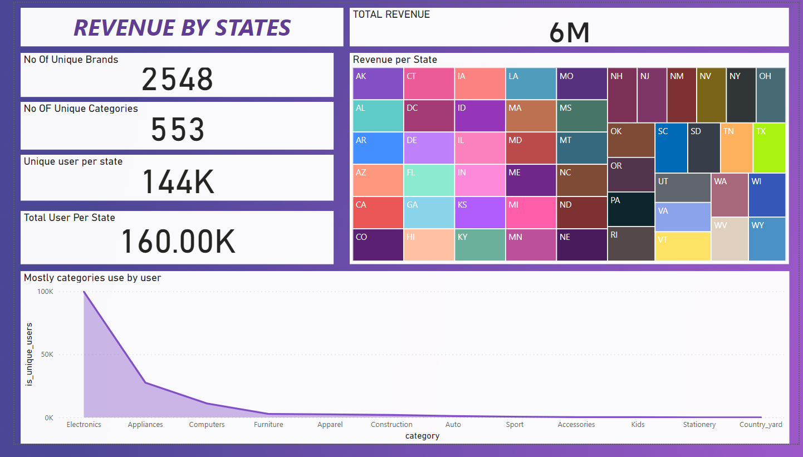

Slide 18
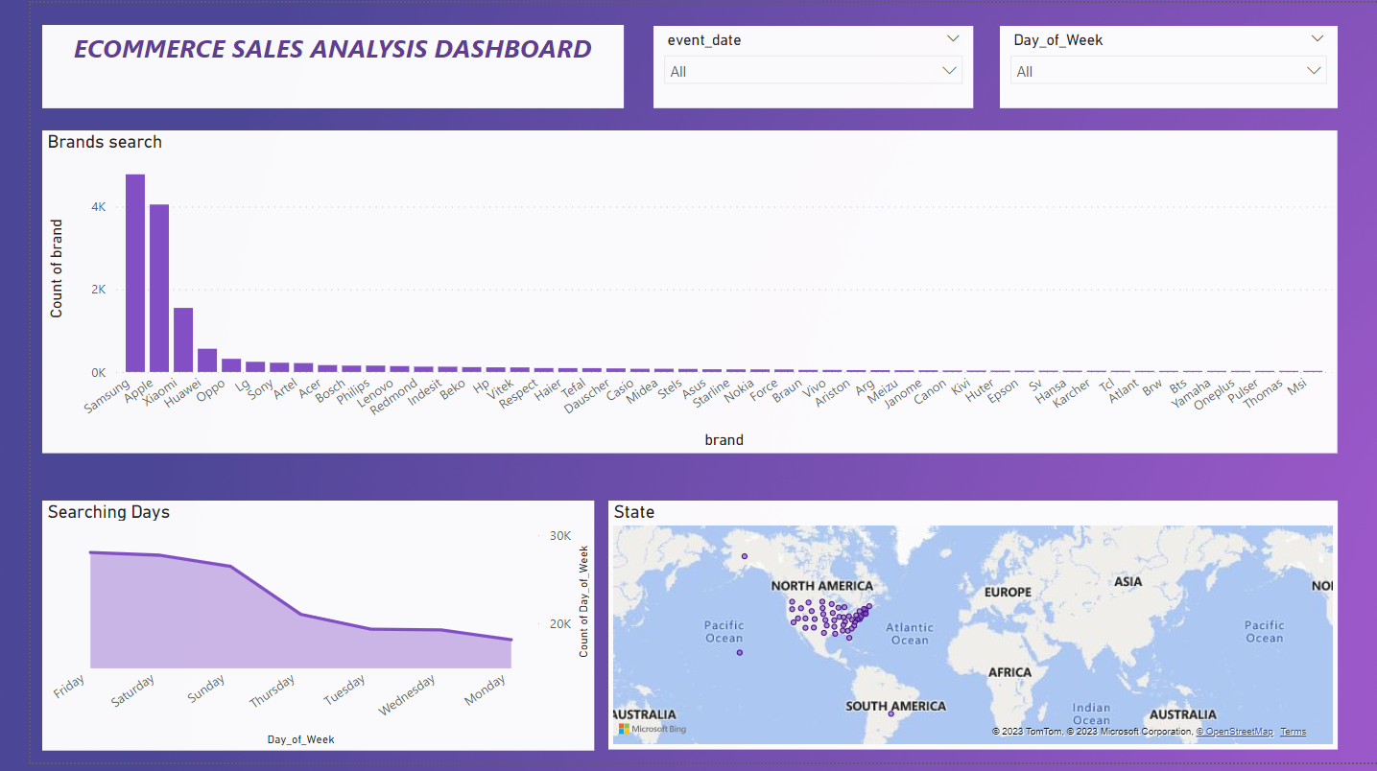

Slide 19
Thank You

